Slide 1

Abstract Factory Pattern
Creational, Object focused

Slide 2
Motivation
Often apps need to target multiple platforms (MacOS v. Windows)
Creating individual classes for every possible look-and-feel is intractable
We need a way to make the application portable without requiring a major overhaul for each platform

Slide 3
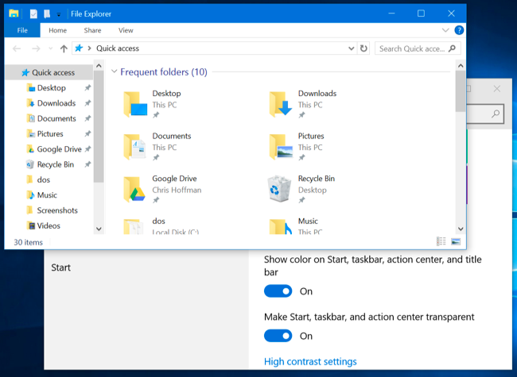
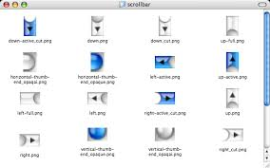
Example
Think of how the look and feel of a scroll bar or the explorer window is different on one platform versus another.

Slide 4
Solution
Separate the logic for the style (look-and-feel) from the internal functionality of the application by creating factories that switch the styling at running time.

Slide 5
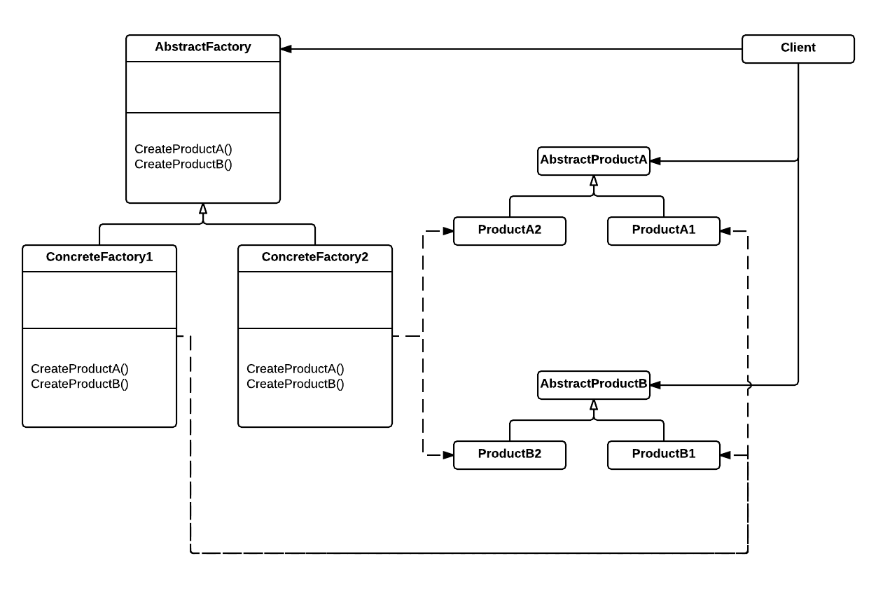
Structure
AbstractFactory: Declares the interface for creating abstract product objects
ConcreteFactory: Implements the interface for a type of product
AbstractProduct: Declares interface for a type of product
ConcreteProduct: Defines a product object to be created
Client: Interacts with the factories and the products through the interface defined by the abstract classes

Slide 6
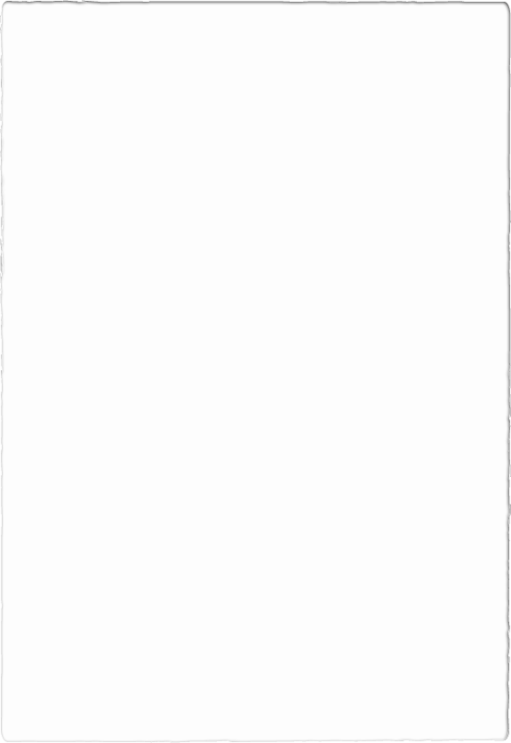
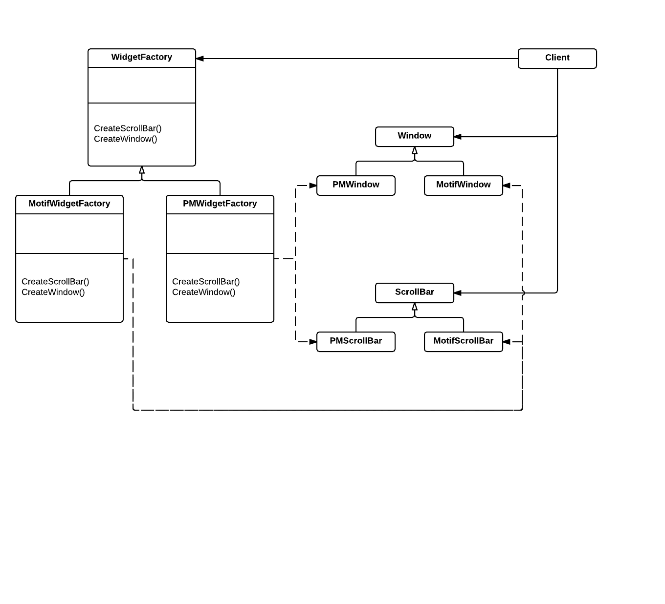
Implementation example

Slide 7
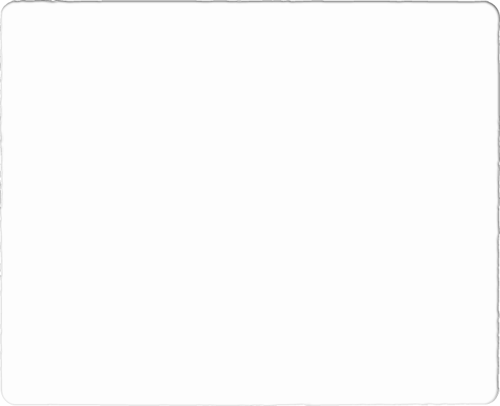
Consequences
Pros:
Isolates concrete classes. Product class names are hidden from client code.
Exchanging product families is easy.
Promotes consistency among products.
Cons:
Supporting new kinds of products is difficult. Requires redesigning the AbstractFactory class and all of its subclasses.

Slide 8
Example from “Design Patterns: Elements of Reusable Object-Oriented Software”
Erich Gamma
Richard Helm
Ralph Johnson
John Vlissides

Slide 9
Back to Lexi
Document structure: Composite Design Pattern
Formatting : Strategy Design Pattern
Embellishing the user interface: Decorator pattern (not seen in class)
Supporting multiple look-and-feel standards: Abstract Factory Pattern
Supporting multiple window systems: ?
User operations: ?
Spelling checking and hyphenation: ?

Slide 10
Problem
Every component inside Lexi is a Glyph. We have positional Glyphs that are invisible. We can also use Glyphs for buttons, scrollbars and other styling elements but we want a way to change them dynamically so we can’t hardcode the style into our application
For example:
ScrollBar* sb = new MotifScrollBar;
Or
ScrollBar* sb = guiFactory->CreateScrollBar();

Slide 11
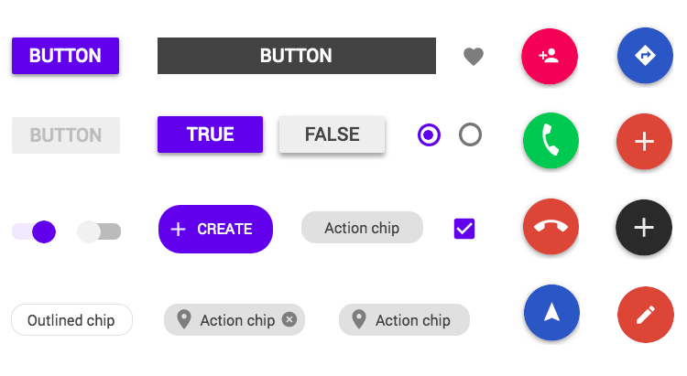
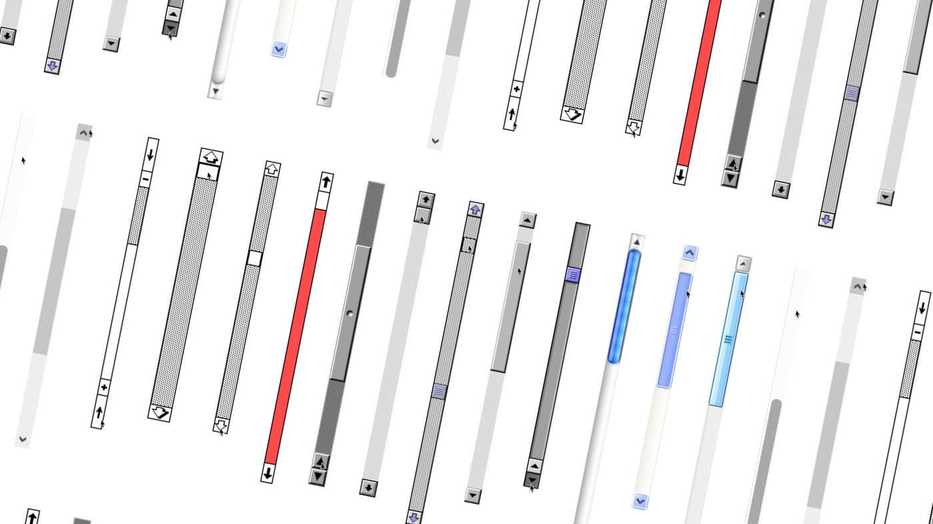
Widget Glyphs
The Glyphs used for styling will be called Widget Glyphs, and there are two groups:
Abstract Glyph subclasses for each category of widget Glyph
ScrollBar
Buttons
Concrete subclasses for each abstract subclass
MacScrollBar
Win10Button

Slide 12
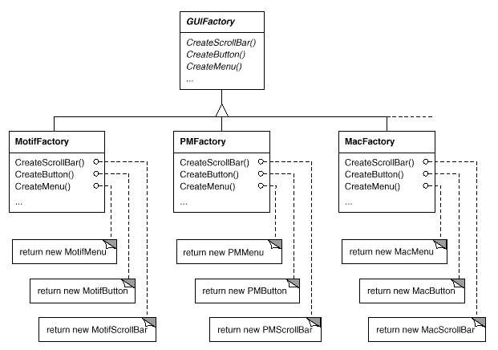
The factory
GUIFactory is the abstract factory class that defines the interface
The concrete factories have the same interface but will instantiate a different family of products

Slide 13
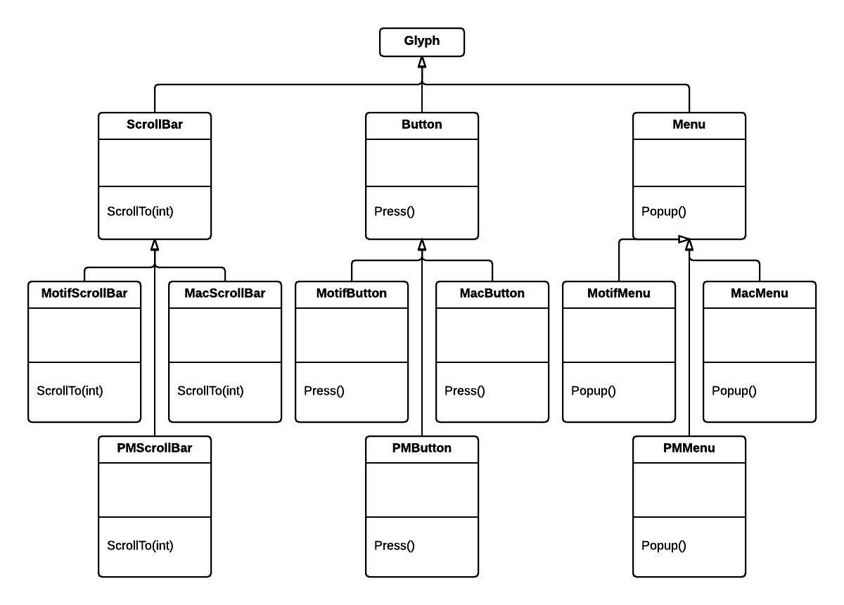
The product
Although products are Glyphs, each product family has its own abstract class (Scrollbar, Button and Menu)
Concrete products match the concrete factories

Slide 14
Implementation

Slide 15
C++ Implementation
Don’t hard code the concrete product names into C++ MacMenu* mac_menu = new MacMenu();
Now if we change it to Motif MotifMenu* motif_menu = new MotifMenu();
We have to change this for every instance: Find/Replace mac_menu => motif_menu
This would also need to be done with all buttons and scroll bars
How can we generalize this?

Slide 16
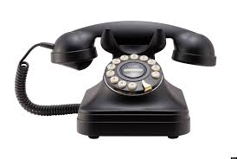

C++ Implementation
Generalized to standardize the interface ScrollBar* scroll_bar = new MacScrollBar();
Hello! I’d like to order a nice new ScrollBar() please.
John Smith
Mac User

Slide 17
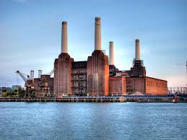

C++ Implementation
Generalized to minimize look-and-feel dependencies
ScrollBar* scroll_bar = guiFactory->CreateScrollBar();
Hello! I’d like to order a nice new ScrollBar() please.
Motif Factory
John Smith
Mac Factory
John Smith
Mac User

Slide 18
C++ Implementation
Generalized to minimize look-and-feel dependencies
ScrollBar* scroll_bar = guiFactory->CreateScrollBar();
Hello! I’d like to order a nice new ScrollBar() please.
Motif Factory
John Smith
Motif User
John Smith
Mac Factory

Slide 19
C++ Implementation
Generalized to minimize look-and-feel dependencies Button* button = guiFactory->CreateButton();
Hello! I’d like to order a nice new Button() please.
Motif Factory
John Smith
Motif User
John Smith
Mac Factory

Slide 20
Code example
GUIFactory* guiFactory;
const char* styleName = getenv(“LOOK_AND_FEEL”); if(strcmp(styleName, “Mac”) == 0) {
guiFactory = new MacFactory;
} else if (strcmp(styleName, “Win10”) == 0) { guiFactory = new Win10Factory;
} else {
guiFactory = new DefaultGUIFactory; }

Slide 21
Review
Factories and products are the key participants in the Abstract Factory
This pattern captures how to create families of related product objects without instantiating classes directly
It is most appropriate when the number and general kinds of product objects stay constant, and there are differences in specific product families
We choose between families by instantiating a particular concrete factory and using it to create consistent products thereafter
We can swap entire families by replacing the concrete factory
Abstract Factory pattern emphasizes families of products

Slide 22
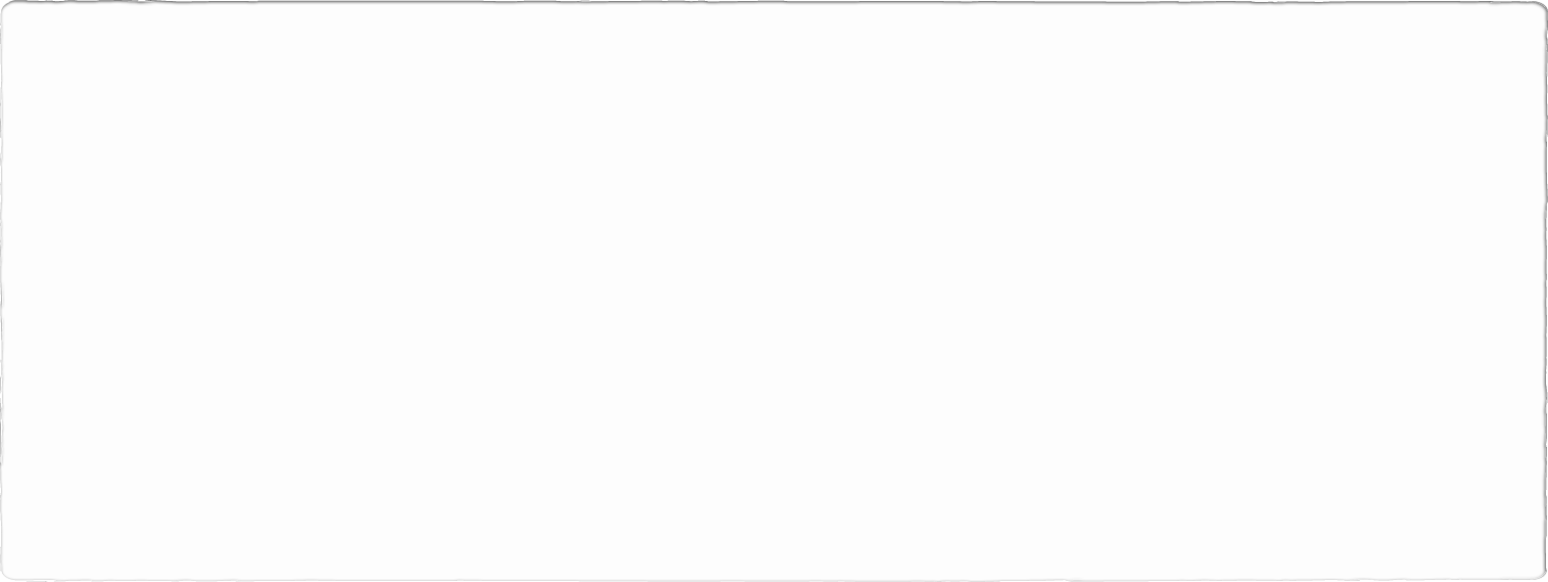

Questions?

